Slide 1

Semantic Kernel
Pranab Paul

Slide 2




What is Semantic Kernel?
An open-source SDK that lets you easily build agents that call your existing code. As a highly extensible framework, it can be used with models from OpenAI, Azure OpenAI, Hugging Face, and more!
By combining your existing C#, Python, and Java code with these models, you can build agents that answer questions and automate processes.
Python
Java
.Net

Slide 3

A bridge between LLMs and your code
Your models
Your code
ML RESEARCHER
APP DEVELOPER
keeping up with advances
stable and performant
cutting edge models
efficient to deliver
algorithm analysis
easily scalable
experimentation
maintainable
Your memories
Your prompts

Slide 4
Application Architecture
UX
Shared UI Components
SDKs
APIs
Dynamic Prompting
Variable Substitution
(Language-specific) App Framework
Safety / RAI
Templating
App Runtime
Plugins
Discovery
Evaluation
Relevancy
Creation
Planning
Accuracy
Orchestration
Inference Scheduling ("hybrid")
Memory
Persistence
Relevance
Cleanup
AuthZ/N
Knowledge
(State)
Content
Retrieval
Unstructured data (via Embeddings and/or IR search)
Compliance
Structured data (via NL2Query)
API data (via NL2API)
Foundational LLMs
Fine-tuned models
Supplementary Models
Micro-LLMs (edge optimized)
AI Platform

Slide 5
Application Architecture
UX
Shared UI Components
SDKs
APIs
Semantic Kernel
is here
Dynamic Prompting
Variable Substitution
(Language-specific) App Framework
Safety / RAI
Templating
App Runtime
Plugins
Discovery
Evaluation
Relevancy
Creation
Planning
Accuracy
Orchestration
Inference Scheduling ("hybrid")
Memory
Persistence
Relevance
Cleanup
AuthZ/N
Knowledge
(State)
Content
Retrieval
Unstructured data (via Embeddings and/or IR search)
Compliance
Structured data (via NL2Query)
API data (via NL2API)
Foundational LLMs
Fine-tuned models
Supplementary Models
Micro-LLMs (edge optimized)
AI Platform

Slide 6
Why Should MSFT Own an AI Orchestrator?
The space is nascent – we can help drive it
Competitive AI orchestrators -
Might, or might not, integrate well with the MSFT platform (e.g., Hibernate)
We have little/no control or influence with them
We can move quickly and integrate with MSFT tech
Easier for us to track changes and build an aligned story (runtimes and tools) for something we own
Some components, e.g., Planners will have IP
Security/production-ready needs can be met more easily

Slide 7
Plugins &
These are the core building blocks of Semantic Kernel. By customizing these key components, you can create solutions to suite exactly your needs.
Planners &
Personas

Slide 8









Plugins
Plugins encapsulate capabilities into a single unit of functionality. When you build a plugin for Semantic Kernel, you can leverage it on other services, like ChatGTP, Bing, and Microsoft 365. Likewise, any plugin built for those services can seamlessly import to Semantic Kernel.
Plugins
Other AI apps
Semantic Kernel
Your app

Slide 9







Semantic or native?
To make a plugin, you'll need to create some functions. These are either semantic or native – you decide.
Time plugin
Semantic functions
Semantic functions
Endpoint
Semantic Kernel

Slide 10



Planners
Person has a request
A Planner is a function that takes the initial request and returns a list of steps needed to fulfill the request. AI is used to mix-and-match plugins registered in the kernel so it can recombine them into a series of steps.
Semantic Kernel
Plugins
Plan

Slide 11


Handlebars or stepwise?
To make plans, you'll need to define which planner to use. Choose between handlebars or stepwise planner.
Planner
Handlebars
Stepwise

Slide 12




Personas
Project manager agent
Personas are what defines an agent's role, like a set of instructions. They hold their own memories which provide broader context to the requests made.
This is what empowers multi-agent systems where specialists are defined to execute requests they were designed to fulfil.
Researcher agent
Copywriter agent
Designer agent

Slide 13
Managing personas
Agent orchestrator plugin
Through plugins, planners orchestrate agents. Choosing the best agent for the request.
Project manager agent
Researcher agent
Copywriter agent
Designer agent

Slide 14
Memories
This is what provides context to the initial request. Memories are fed into Semantic Kernel in a few different ways.
Conventional key-value pairs: Just like you would set an environment variable in your shell, the same can be done when using Semantic Kernel. The lookup is "conventional" because it's a one-to-one match between a key and your query.
Conventional local-storage: When you save information to a file, it can be retrieved with its filename. When you have a lot of information to store in a key-value pair, you're best off keeping it on disk.
Semantic memory search: You can also represent text information as a long vector of numbers, known as "embeddings." This lets you execute a "semantic" search that compares meaning-to-meaning with your query.

Slide 15
Prompts
This is how you communicate with model. It serves as the input which elicits a response from the model. Selecting the right words, phrases, symbols, and formats that guide the model in generating high-quality and relevant results.

Slide 16
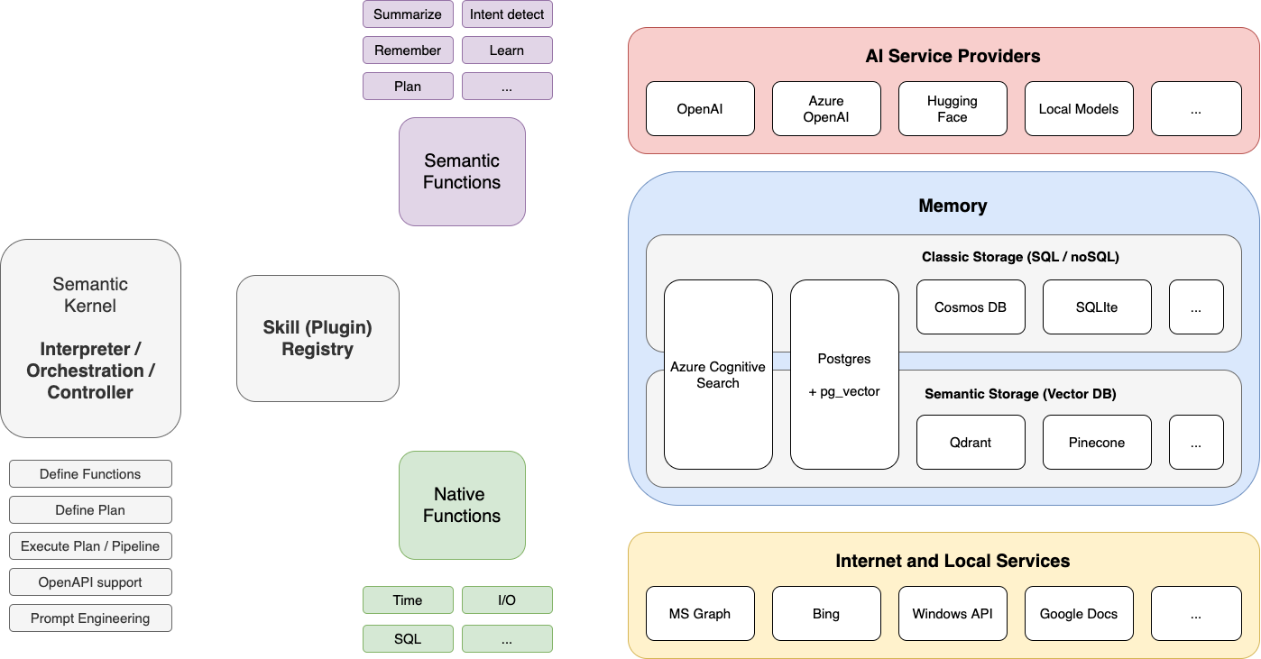
Semantic Kernel Architecture

